Slide 1

SpaceX scenario
Hady Hassan
8 / 2 / 2024

Slide 2
Introduction
SpaceX, a leader in the space industry, strives to make space travel affordable for everyone.
Its accomplishments include sending spacecraft to the international space station, launching a satellite constellation that provides internet access and sending manned missions to space.
SpaceX can do this because the rocket launches are relatively inexpensive ($62 million per launch) due to its novel reuse of the first stage of its Falcon 9 rocket. Other providers, which are not able to reuse the first stage, cost upwards of $165 million each.
By determining if the first stage will land, we can determine the price of the launch. To do this, we can use public data and machine learning models to predict whether SpaceX –or a competing company –can reuse the first stage.

Slide 3
Objectives
Determine the cost of a launch.
How payload mass, launch site, number of flights, and orbits affect first stage landing success
Rate of successful landings over time
Best predictive model for successful landing (binary classification)

Slide 4
methodology
Collect data using SpaceX REST API and web scraping techniques
Wrangle data by filtering the data, handling missing values and applying one hot encoding to prepare the data for analysis and modeling
Explore data via EDA with SQL and data visualization techniques
Visualize the data using Folium and Plotly Dash
Build Models to predict landing outcomes using classification models. Tune and evaluate models to find best model and parameters

Slide 5
Data collection API
Request data from SpaceX API (rocket launch data) Decode response using . json () and convert to a dataframe using . Json normalize
Request information about the launches from SpaceX API using custom functions
Create dictionary from the data
Create dataframe from the dictionary
Filter dataframe to contain only Falcon 9 launches
Replace missing values of Payload Mass with calculated .mean()
Export data to csv file
Data Collection

Slide 6
Data collection Scraping
Request data (Falcon 9 launch data) from Wikipedia
Create BeautifulSoup object from HTML response
Extract column names from HTML table header
Collect data from parsing HTML tables
Create dictionary from the data
Create dataframe from the dictionary
Export data to csv file

Slide 7
Data wrangling
Perform EDA and determine data labels
Calculate:
# of launches for each site
# and occurrence of orbit
# and occurrence of mission (outcome per orbit type]
Create binary landing outcome column (dependent variable)
Export data to csv file

Slide 8
Data wrangling cont.
False Ocean:
represented an unsuccessful landing to a specific region of ocean
True RTLS:
meant the mission had a successful landing on a ground pad
False RTLS:
represented an unsuccessful landing on a ground pad
True ASDS:
meant the mission outcome had a successful landing on a drone ship.

Slide 9
Data wrangling Cont.
False ASDS:
represented an unsuccessful landing on drone ship
Outcomes converted into 1 fora successful landing and 0 for an unsuccessful landing Landing Outcome Cont. Landing Outcome
Landing was not always successful
True Ocean:
mission outcome had a successful landing to a specific region of the ocean.

Slide 10
Eda with SQL queries
Display:
Names of unique launch sites
5 records where launch site begins with ‘CCA’
Total payload mass carried by boosters launched by NASA (CRS)
Average payload mass carried by booster version F9 v1.1.

Slide 11
Eda with visualization
Charts:
Flight Number vs. Payload
Flight Number vs. Launch Site
Payload Mass (kg) vs. Launch Site
Payload Mass (kg) vs. Orbit type EDA with Visualization Analysis
View relationship by using scatter plots . The variables could be useful for machine learning if a relationship exists
Show comparisons among discrete categories with bar charts . Bar charts show the relationships among the categories and a measured value.

Slide 12
Predictive analysis
NumPy array from the Class column
Standardize the data with StandardScaler. Fit and transform the data.
Split the data using train_test_split
Create a GridSearchCV object with cv=10 for parameter optimization
Apply GridSearchCV on different algorithms: logistic regression (LogisticRegression()), support vector machine (SVC()), decision tree (DecisionTreeClassifier()), K Nearest Neighbor (KNeighborsClassifier())
Calculate accuracy on the test data using .score() for all models
Assess the confusion matrix for all models
Identify the best model using Jaccard_Score, F1_Score and Accuracy

Slide 13
Results

Slide 14
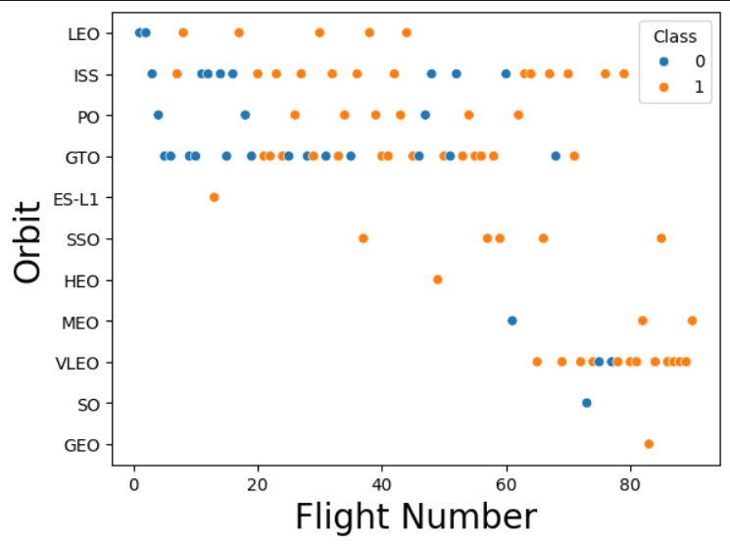
orbit vs flight number
The success
rate typically increases with the number of flights for each orbit
This relationship is highly apparent for the LEO orbit
The GTO orbit, however, does not follow this trend

Slide 15
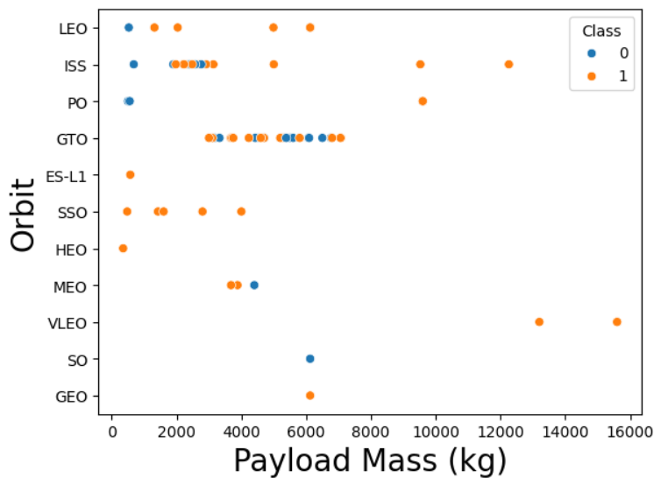
orbit vs payload mass
Heavy payloads are better with LEO, ISS and PO orbits
The GTO orbit has mixed success with heavier payloads

Slide 16
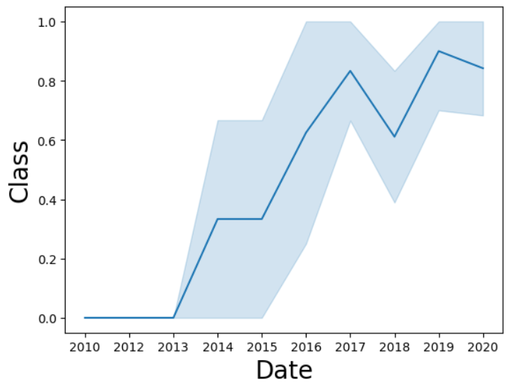
Launch Success over Time
The success rate improved from 2013 -2017 and 2018-2019
The success rate decreased from 2017 -2018 and from 2019-2020
Overall, the success rate has improved since 2013

Slide 17
Dashboards

Slide 18
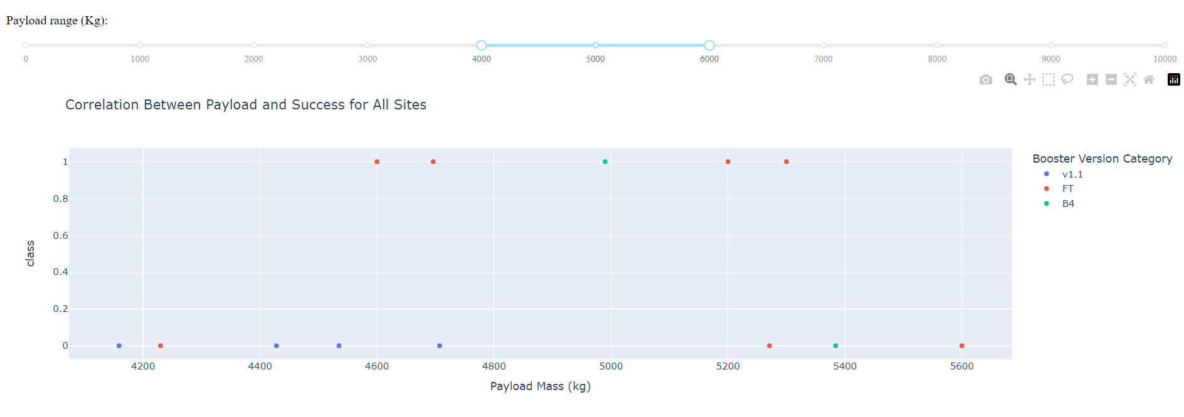
Correlation Between Payload and Success for All Sites

Slide 19
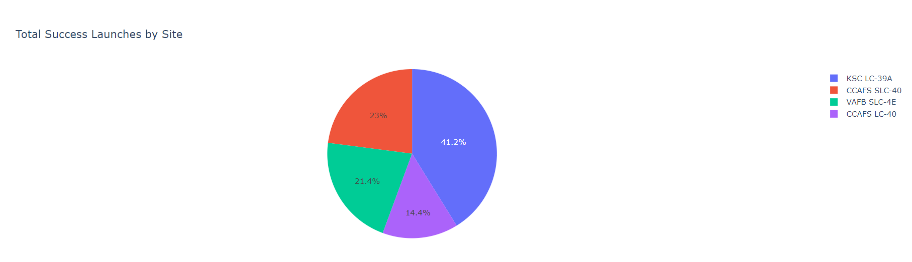
Total Success Launches by Site

Slide 20
Predictive analytics

Slide 21
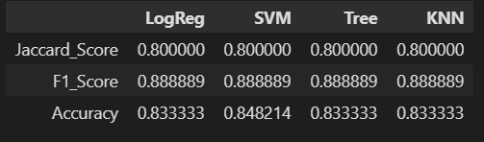
classification
Accuracy
All the models performed at about the same level and had the same scores and accuracy . This is likely due to the small dataset .
The Decision Tree model slightly outperformed the rest when looking at .best_
.best_score_ is the average of all cv folds for a single combination of the parameters

Slide 22
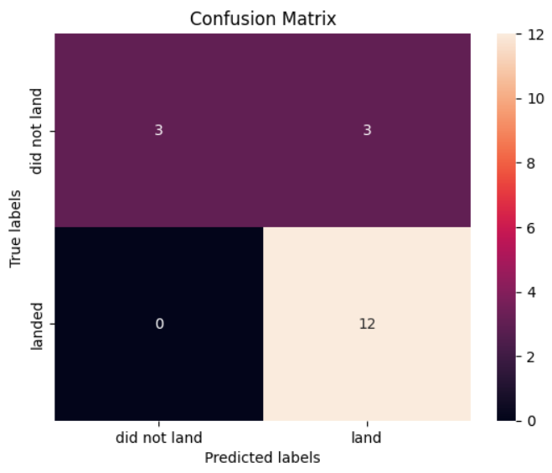
Confusion matrix for all models the same

Slide 23
conclusion
Model Performance : The models performed similarly on the test set with the decision tree model slightly outperforming
Equator: Most of the launch sites are near the equator for an additional natural boost due to the rotational speed of earth which helps save the cost of putting in extra fuel and boosters
Coast All the launch sites are close to the coast
Launch Success: Increases over time
KSC LC39A : Has the highest success rate among launch sites. Has a 100% success rate for launches less than 5,500 kg
Orbits: ES L1, GEO, HEO, and SSO have a 100% success rate
Payload Mass: Across all launch sites, the higher the payload mass (kg), thehigher the success rate

